Slide 1


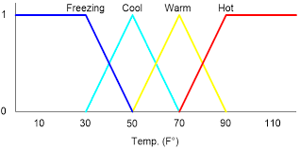
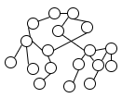
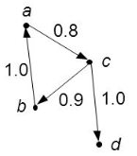
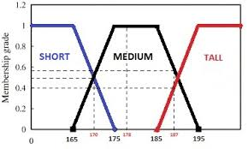

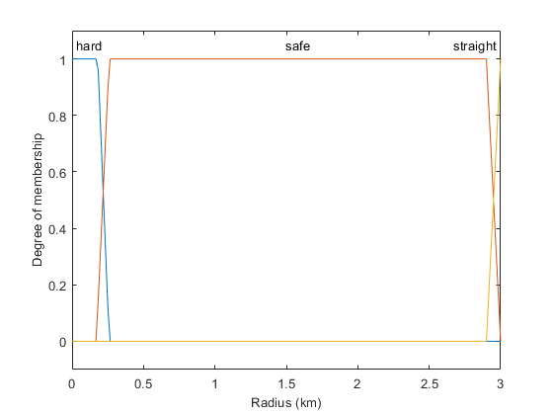
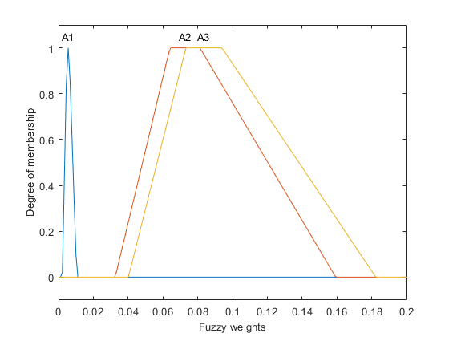
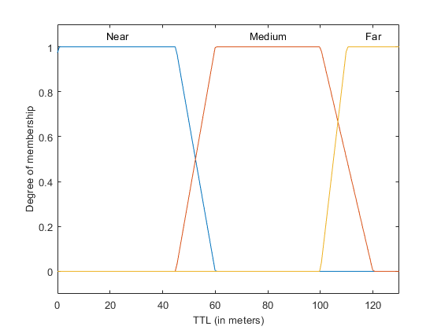
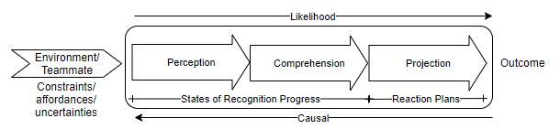
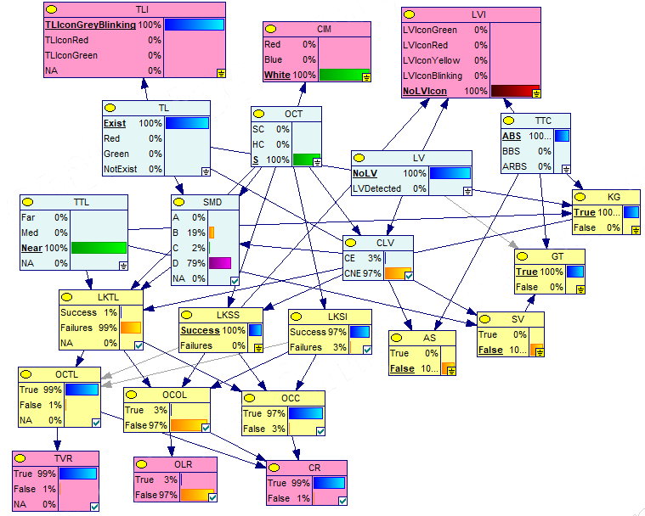
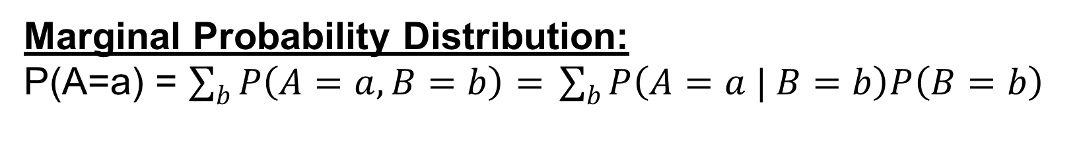
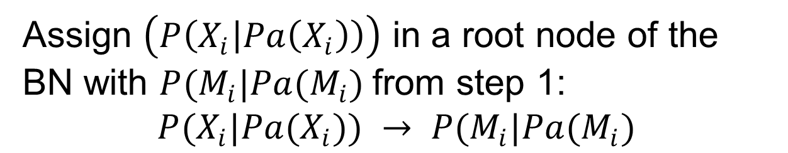
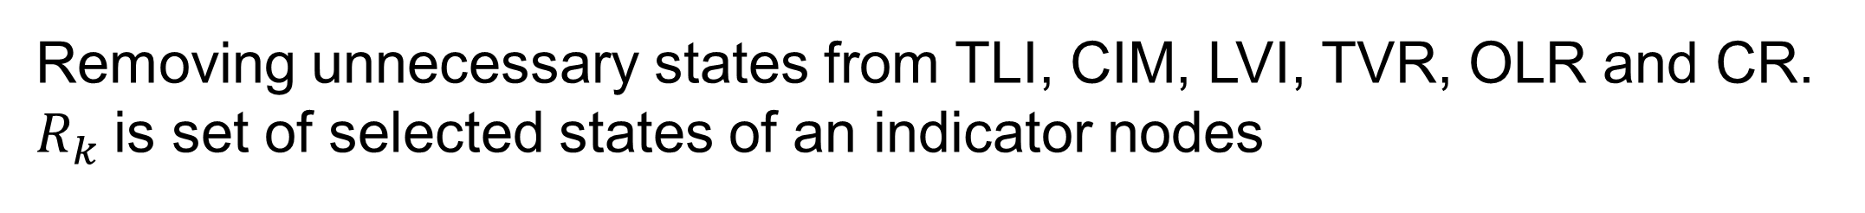
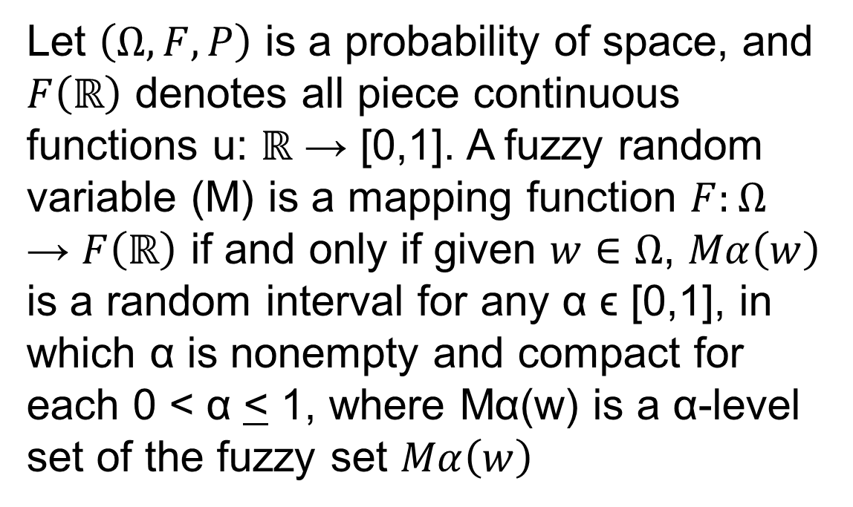
A Fuzzy-Bayesian Based Approach for Intelligent Agent Transparency in Human-Autonomy Teaming
RINTA KRIDALUKMANA | Hai Yan Lu – Mohsen Naderpour
INTRODUCTION
With the advance of artificial situation awareness (SA) technologies, intelligent autonomy agents have been promoted to perform collaborative work with human as a teammate so that a form of human-autonomy teaming (HAT) is established. Such HAT appears in i.e. driving with a car having NHTSA’s Level 3 Automation. The problem is raised as human has over reliance mental model on this agent. Lack of mechanism to comprehend agent’s behavior have been indicated as a contributing factor on such mental model. To mitigate this issue, this study develops an approach to observe agent’s behavior and extract transparency information to assist human comprehension on agent.
Proposed Approach
Step 3
Problem / Question
Materials
Removing unnecessary states from TLI, CIM, LVI, TVR, OLR and CR. $R_{k}$is set of selected states of an indicator nodes
Step 1
Step 2
Step 3
Step 4
Fuzzification of task-related object’s states to feed SADP model
Develop SADP model using Bayesian Network (BN)
Selection process on BN’ output states using Fuzzy Relation
Generate linguistic terms using Mamdani’s defuzzification
Step 4
P(TVR=True) > 0.8 ⬄ “TL will be violated”
P(OLR=True) > 0.9 ⬄ “Probability of out of lane is high”
P(CR=True) > 0.7 ⬄ “High collision risk detected”
Step 1
Evaluation
Project Overview
Let $\left(Ω,F,P\right)$ is a probability of space, and $F\left(ℝ\right)$ denotes all piece continuous functions u: ℝ → [0,1]. A fuzzy random variable (M) is a mapping function $F:Ω$ → $F\left(ℝ\right)$ if and only if given $w∈Ω$, $Mα\left(w\right)$ is a random interval for any α ϵ [0,1], in which α is nonempty and compact for each 0 < α < 1, where Mα(w) is a α-level set of the fuzzy set $Mα\left(w\right)$
Transparency can be described as an effort to provide explanation about why an agent behave like that. This study views that artificial SA development process (SADP) from perception (SA level1), through comprehension (SA level 2), to projection (SA level 3), can reflect agent’s behavior as it plays critical roles on agent’s decision-making process on given situations. Key-transparency information during SADP have been developed as follow:.
Assign $\left(P\left(X_{i} | Pa\left(X_{i}\right)\right)\right)$ in a root node of the BN with $P(M_{i}|Pa(M_{i})$from step 1:
$$P(X_{i}|Pa(X_{i})) → P(M_{i}|Pa(M_{i})$$
Step 2
Conclusion
This study proposes a novel approach by modelling SADP to generate transparency information. The basic principle in SADP model is to capture agent’s perceiving states and examine whether an agent knows every state of necessary related objects and situations affecting agent’s performance on given tasks or not. When the agent fails to recognize a state of objects or situations, it increases the possibility of failures and possible outcomes can be identified.
Proposed approach (A3) compared to component-based model (A1) from Lucas (2001) and functional-based model (A2) from Mercado et al. (2016) and Wortham & Theodorou (2017) using fuzzy hierarchical analysis .
The proposed approach can produce more transparency information whilst a manageable performance can still be achieved
Data / Observations
Input Data
Behavior Observation
Transparency Indicators
References
Lucas, P.J.F. 2001, 'Bayesian model-based diagnosis', International Journal of Approximate Reasoning, vol. 27, no. 2, pp. 99-119
Mercado, J.E., Rupp, M.A., Chen, J.Y., Barnes, M.J., Barber, D. & Procci, K. 2016, 'Intelligent agent transparency in human–agent teaming for Multi-UxV management', Human factors, vol. 58, no. 3, pp. 401-15
Wortham, R.H., Theodorou, A. & Bryson, J.J. 2016, 'What does the robot think? Transparency as a fundamental design requirement for intelligent systems'
.
Real-driving-based data have been simulated to observe agent’s behavior.
Curve road and traffic light (TL) situations are selected as cases on agent’s behavior observation
To summarize transparency information, indicator nodes are set for TL states (TLI), curve type (CIM), lead vehicle (LVI), TL Violation Risk (TVR), Out of lane risk (OLR) and collision risk (CR)
Marginal Probability Distribution:
P(A=a) = $\sum_{b}{P\left(A=a, B=b\right)= }\sum_{b}{P\left(A=a | B=b\right)P\left(B=b\right)}$

